Slide 1
Transmission Media

Slide 2
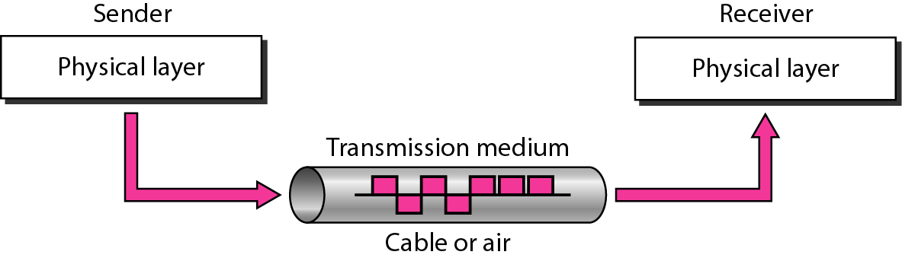
Transmission medium and physical layer

Slide 3
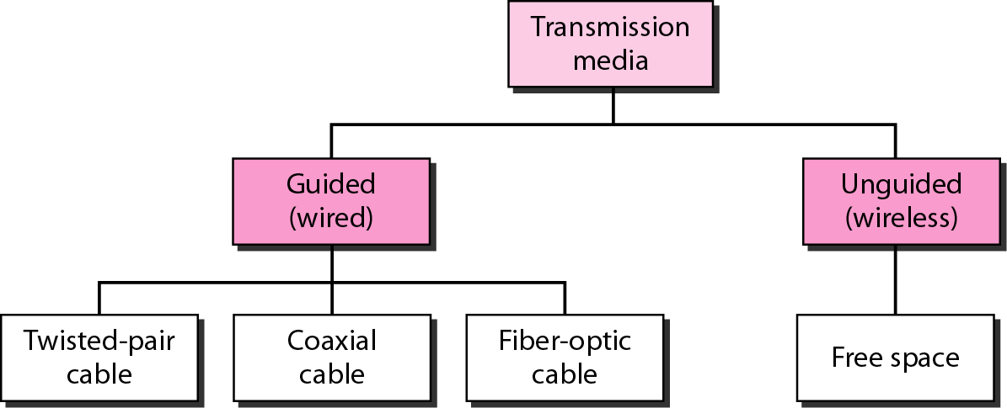
Classes of transmission media

Slide 4
GUIDED MEDIA
Guided media, which are those that provide a conduit from one device to another, include twisted-pair cable, coaxial cable, and fiber-optic cable.
Topics discussed in this section:
Twisted-Pair Cable
Coaxial Cable
Fiber-Optic Cable

Slide 5
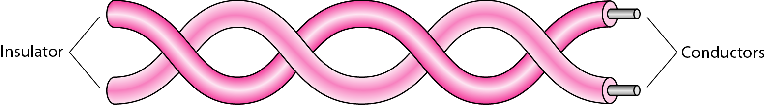
Twisted-pair cable

Slide 6
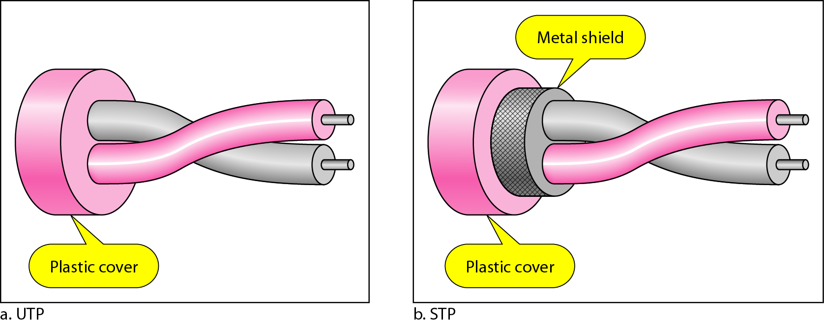
UTP and STP cables

Slide 7
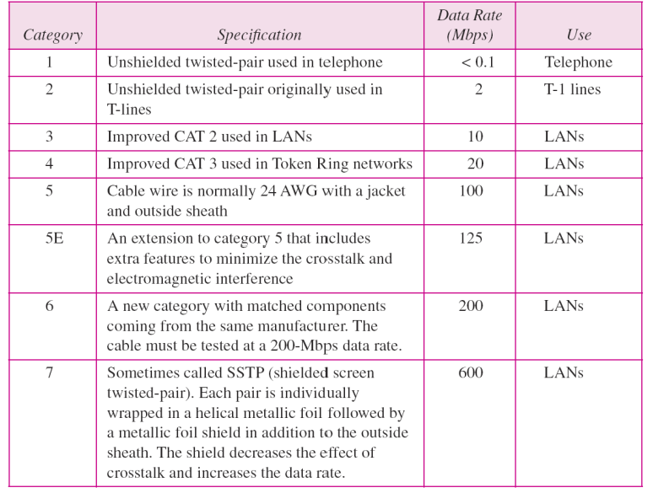
Table Categories of unshielded twisted-pair cables

Slide 8
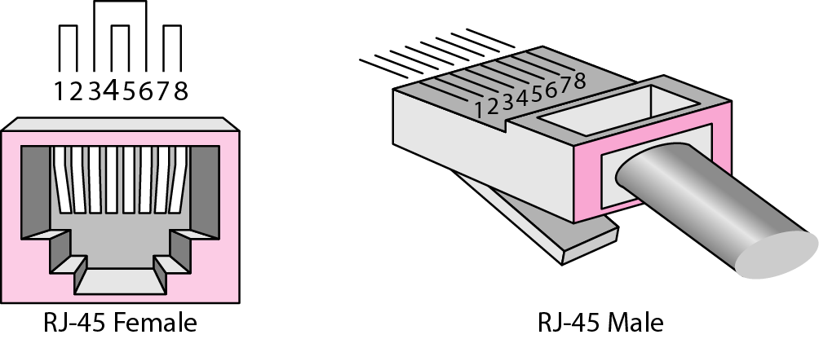
UTP connector

Slide 9
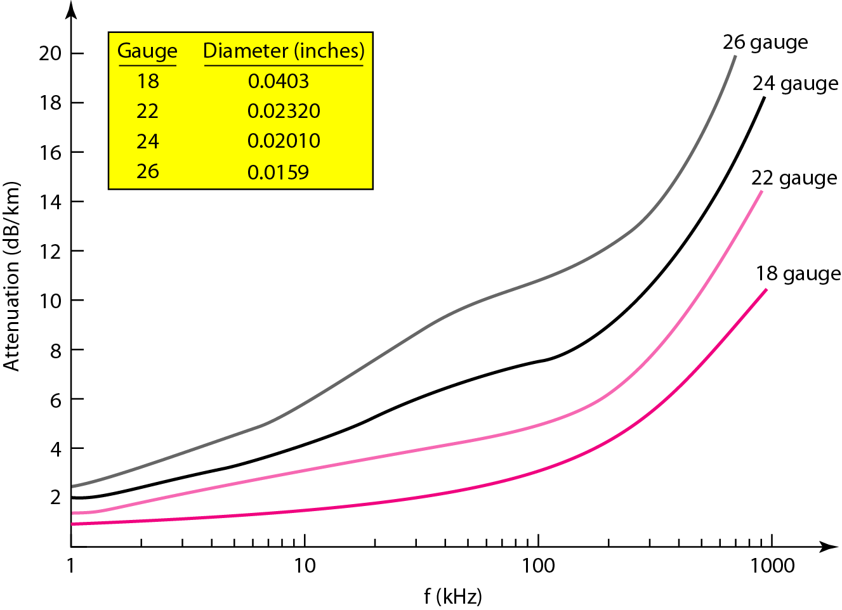
UTP performance

Slide 10
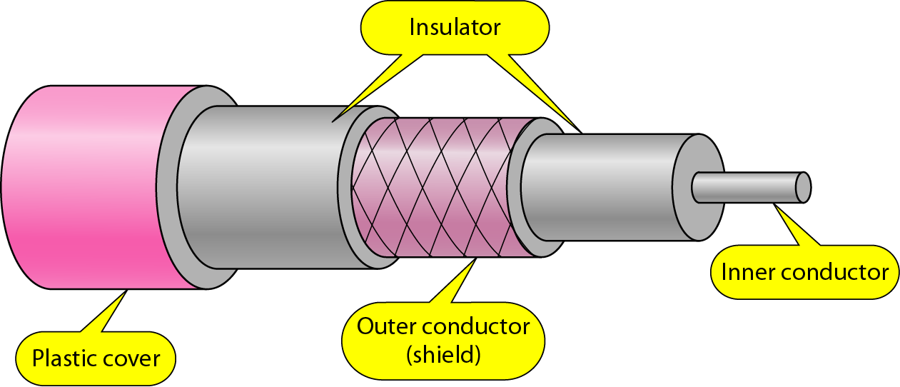
Coaxial cable

Slide 11
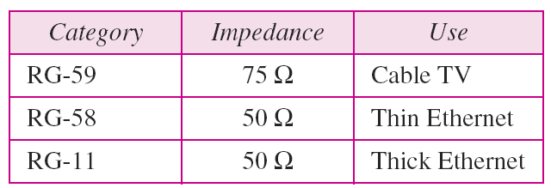
Table 7.2 Categories of coaxial cables

Slide 12
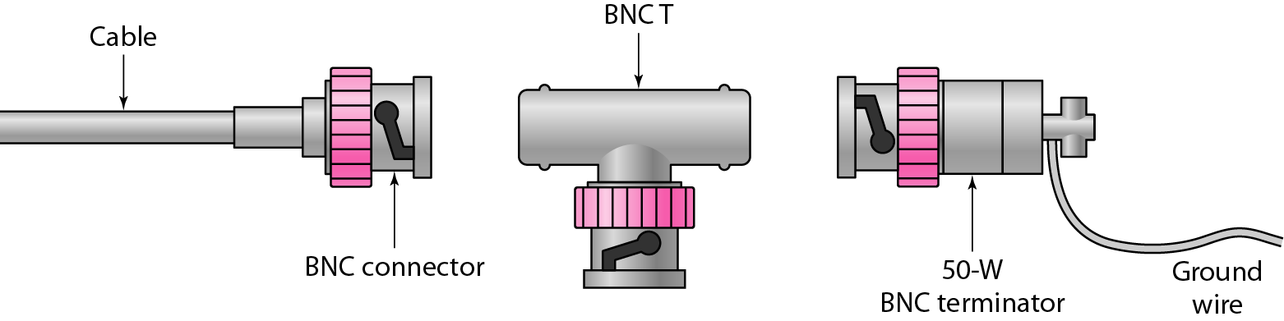
BNC connectors

Slide 13
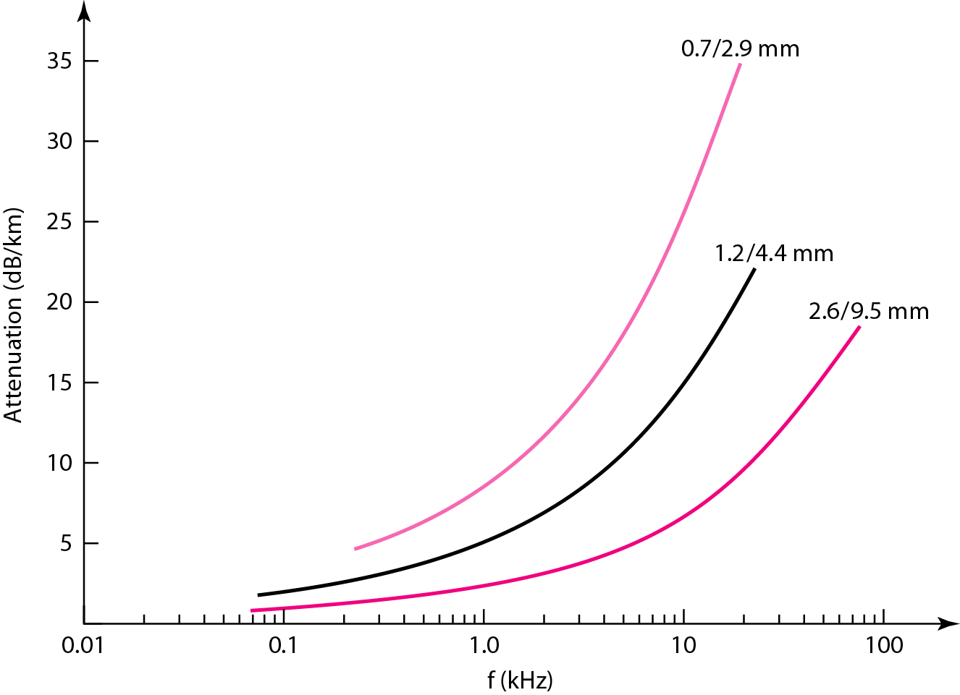
Coaxial cable performance

Slide 14
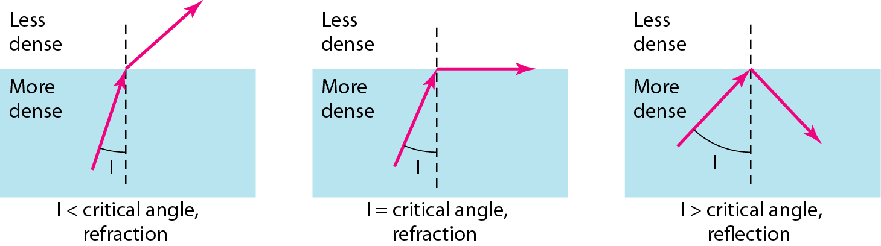
Fiber optics: Bending of light ray

Slide 15
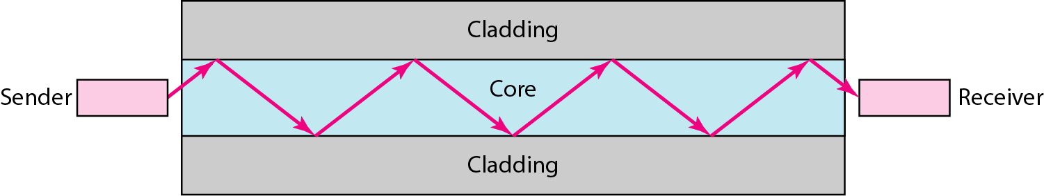
Optical fiber

Slide 16
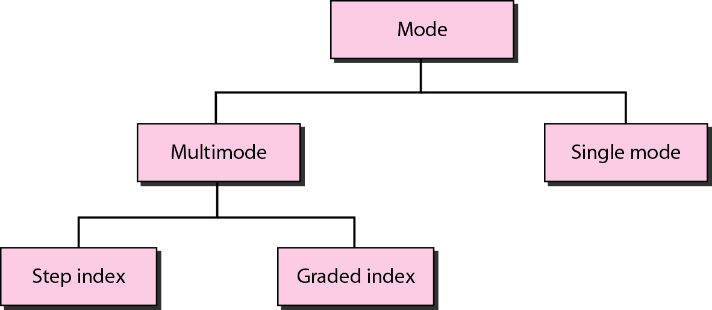
Propagation modes

Slide 17
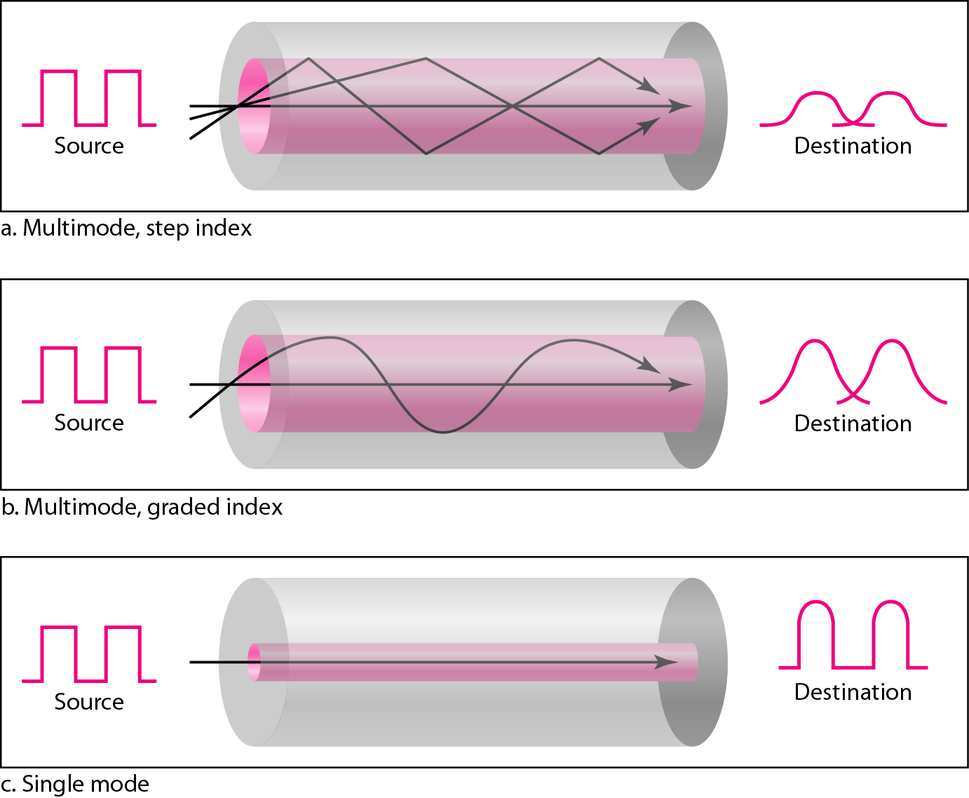
Modes

Slide 18
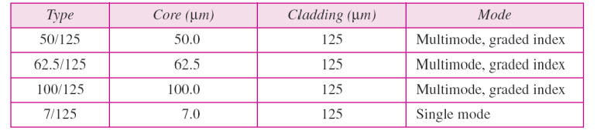
Table Fiber types

Slide 19
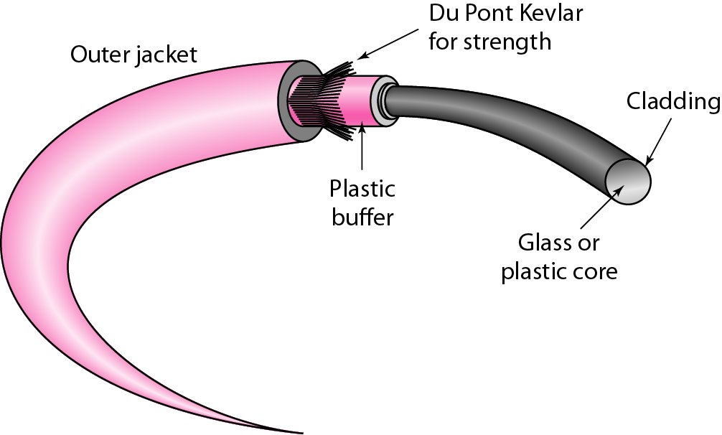
Fiber construction

Slide 20
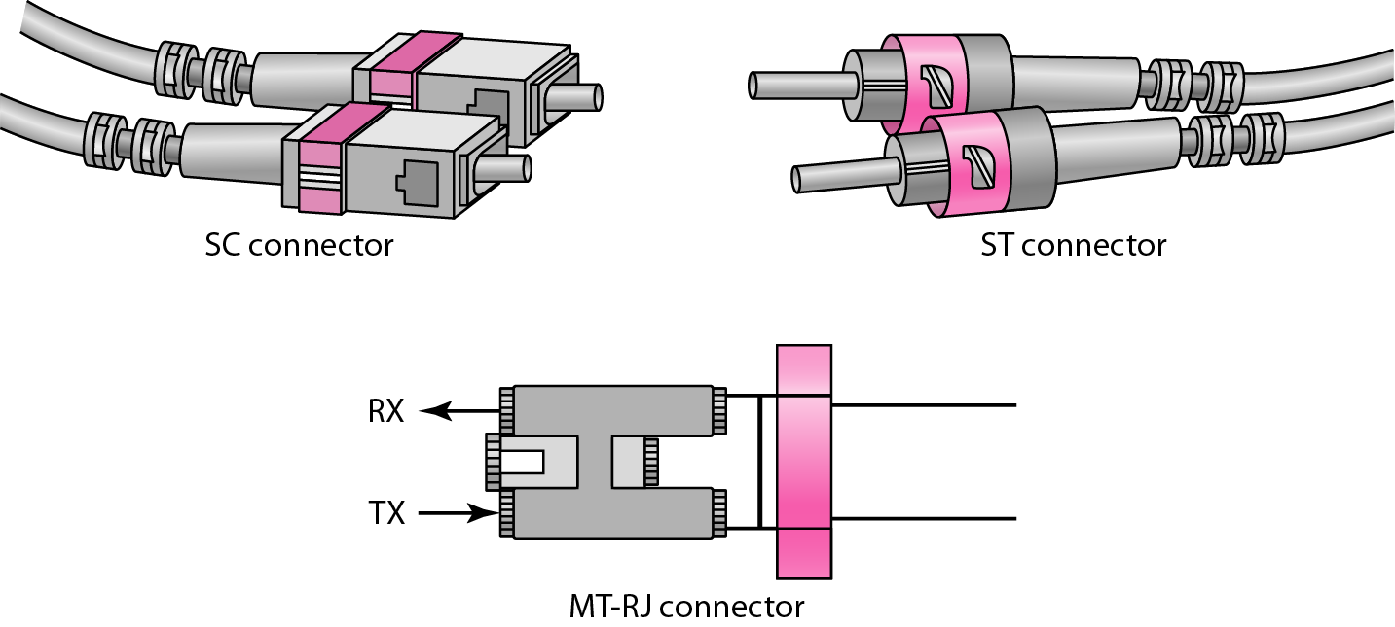
Fiber-optic cable connectors

Slide 21
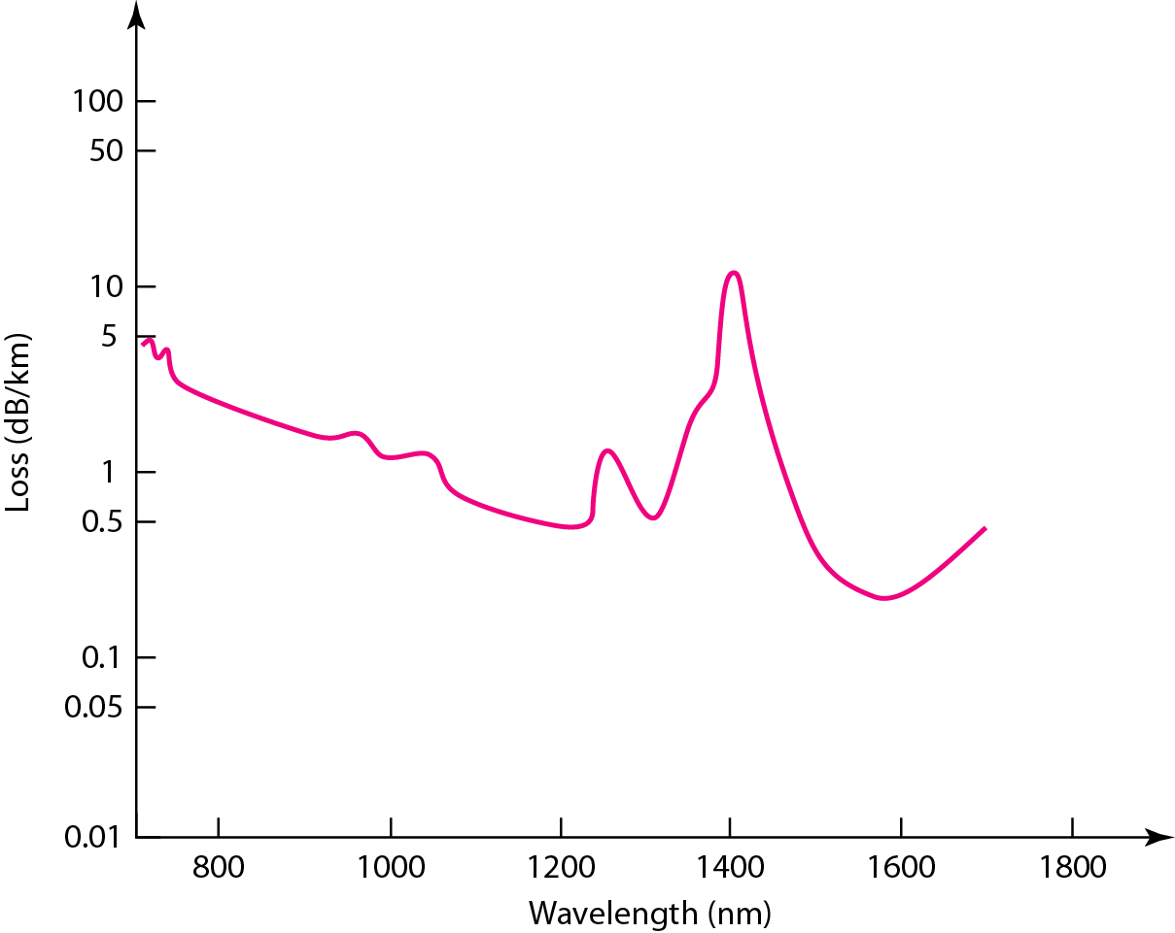
Optical fiber performance

Slide 22
UNGUIDED MEDIA: WIRELESS
Unguided media transport electromagnetic waves without using a physical conductor. This type of communication is often referred to as wireless communication.
Topics discussed in this section:
Radio Waves
Microwaves
Infrared

Slide 23
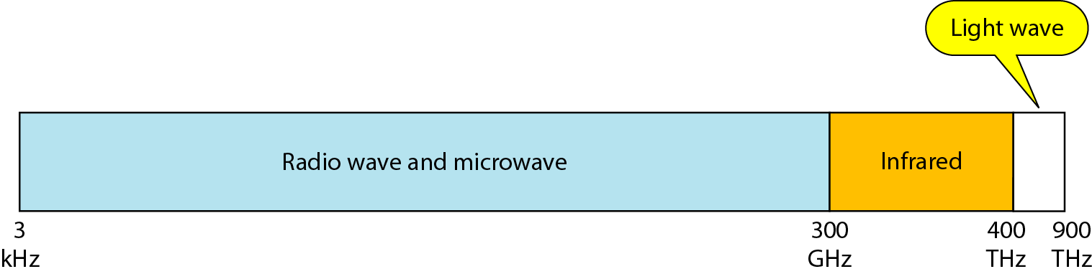
Electromagnetic spectrum for wireless communication

Slide 24
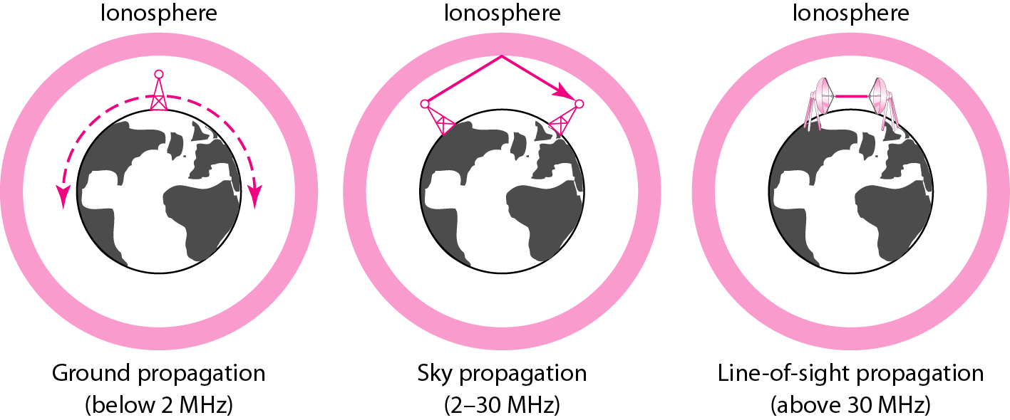
Propagation methods

Slide 25
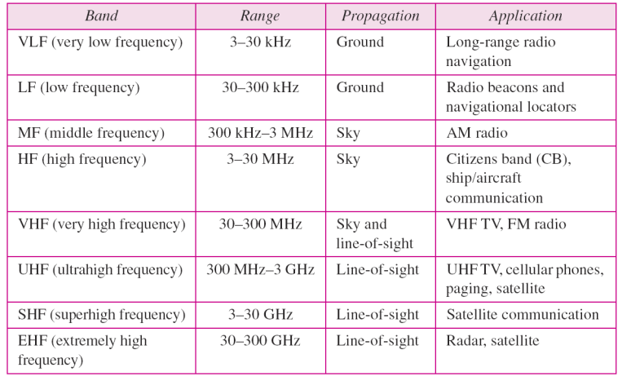
Bands

Slide 26
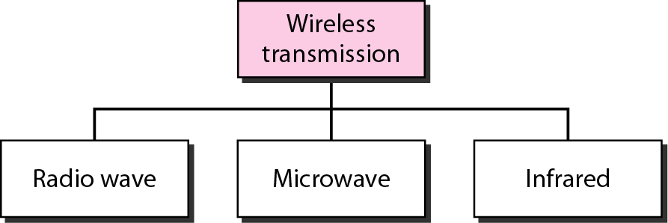
Wireless transmission waves

Slide 27

Note
Radio waves are used for multicast communications, such as radio and television, and paging systems. They can penetrate through walls.
Highly regulated. Use omni directional antennas

Slide 28
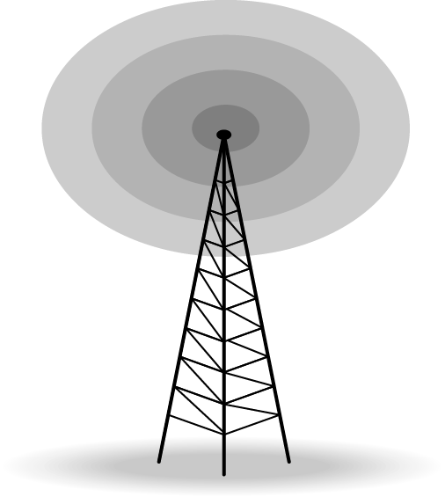
Omnidirectional antenna

Slide 29
Note
Microwaves are used for unicast communication such as cellular telephones, satellite networks,
and wireless LANs.
Higher frequency ranges cannot penetrate walls.
Use directional antennas - point to point line of sight communications.

Slide 30
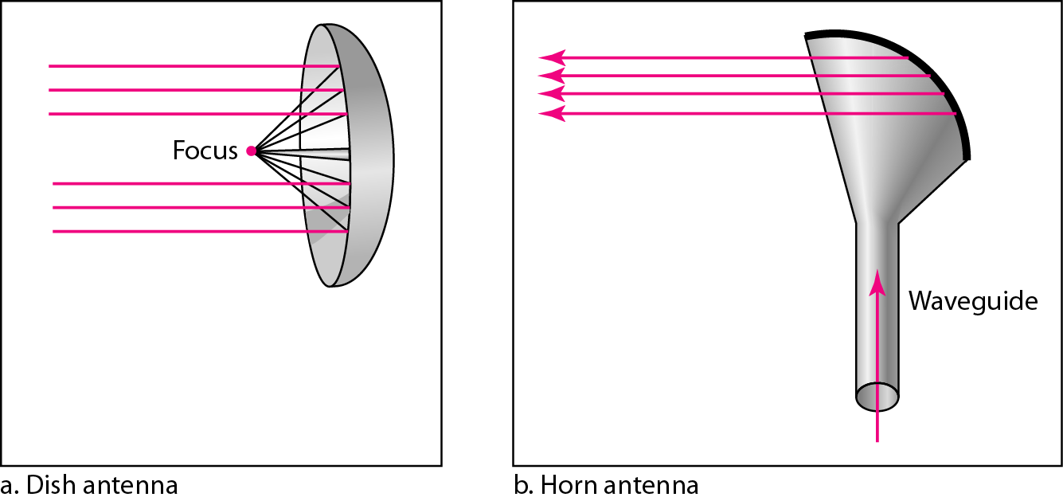
Unidirectional antennas

Slide 31
Note
Infrared signals can be used for short-range communication in a closed area using line-of-sight propagation.

Slide 32
Wireless Channels
Are subject to a lot more errors than guided media channels.
Interference is one cause for errors, can be circumvented with high SNR.
The higher the SNR the less capacity is available for transmission due to the broadcast nature of the channel.
Channel also subject to fading and no coverage holes.

